Slide 1
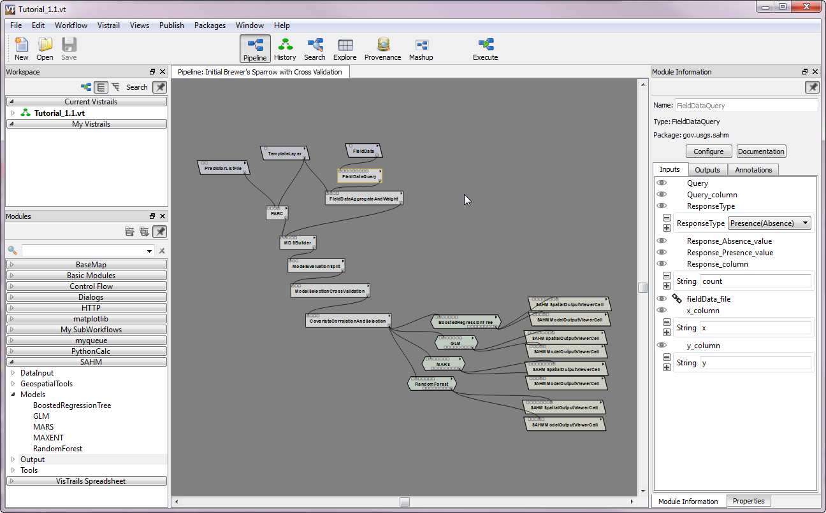
The standard menu bar to open files and load packages
Switch between views
Click Execute to run the workflow
After opening the tutorial it should appear here
View documentation of selected Module
When you click on a module it is selected and its outline turns from black to gold.
Change parameters for selected Module. Click labels to expand. Chain link icon means the value comes from a connection.
SAHM should be loaded
All of the SAHM modules are organized by function click on the arrow to expand

Slide 2
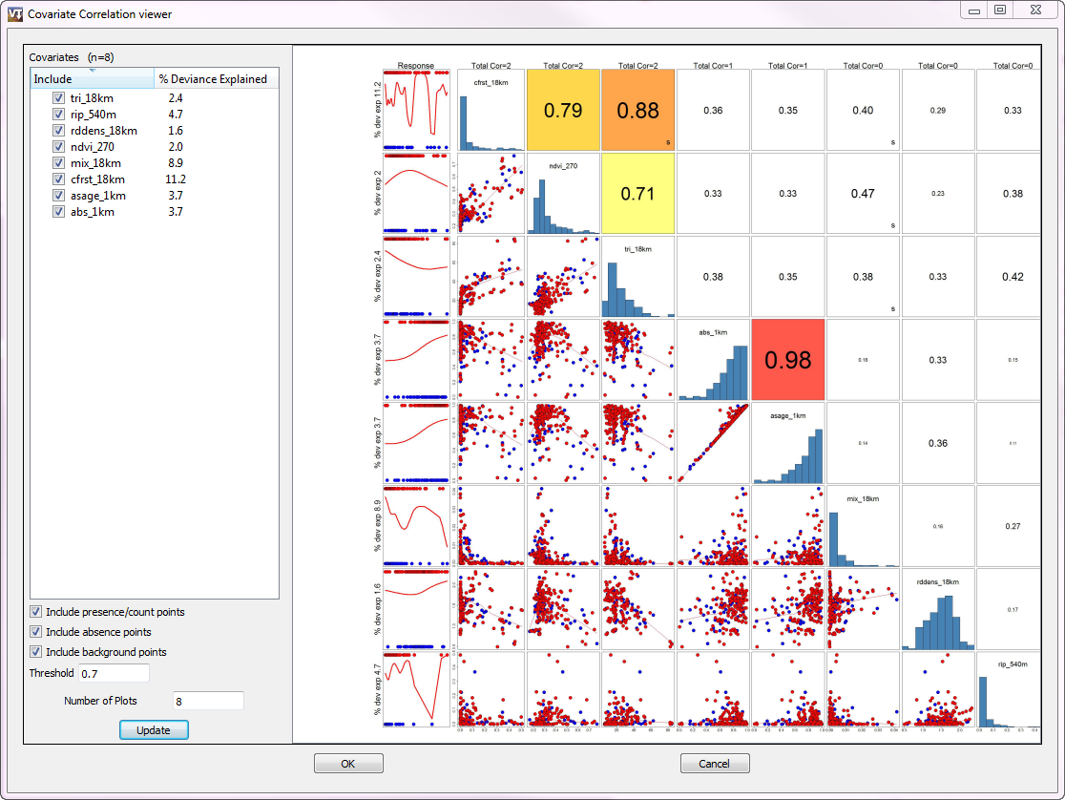
To compare predictors follow the labeled histograms up and to the right for correlation and down and to the left for their scatterplot
Checked parameters appear in the display and will be used in subsequent modeling. Double clicking on the parameter text here will bring up the predictor inspector
Follow the predictor to the far left to see its relationship to the response
Update regenerates the plot after removing unchecked predictors
OK continues the workflow with the checked predictors

Slide 3
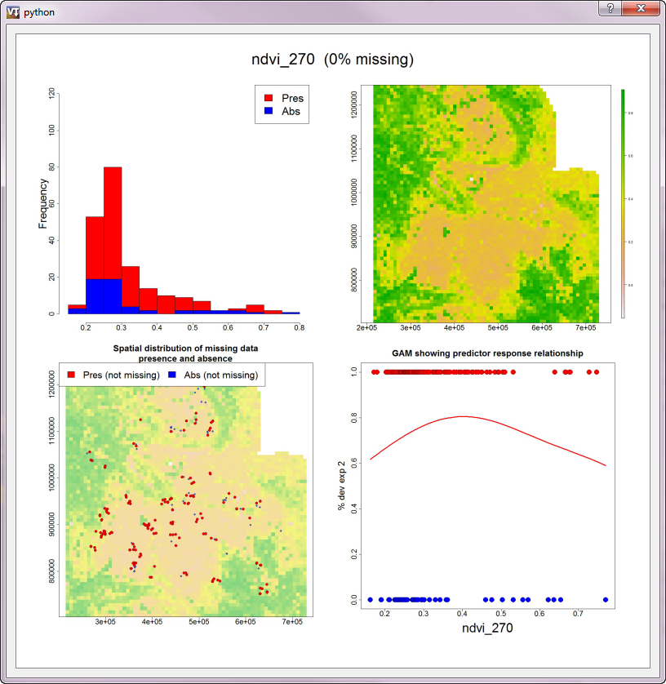

Slide 4
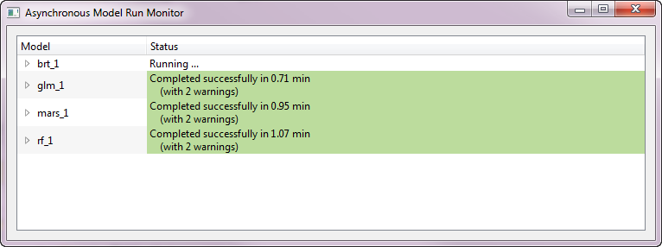
White means the Model is still Running
Green means the Model finished successfully
Models that fail will turn Red.
Click the triangle to the left to view possible error messages

Slide 5
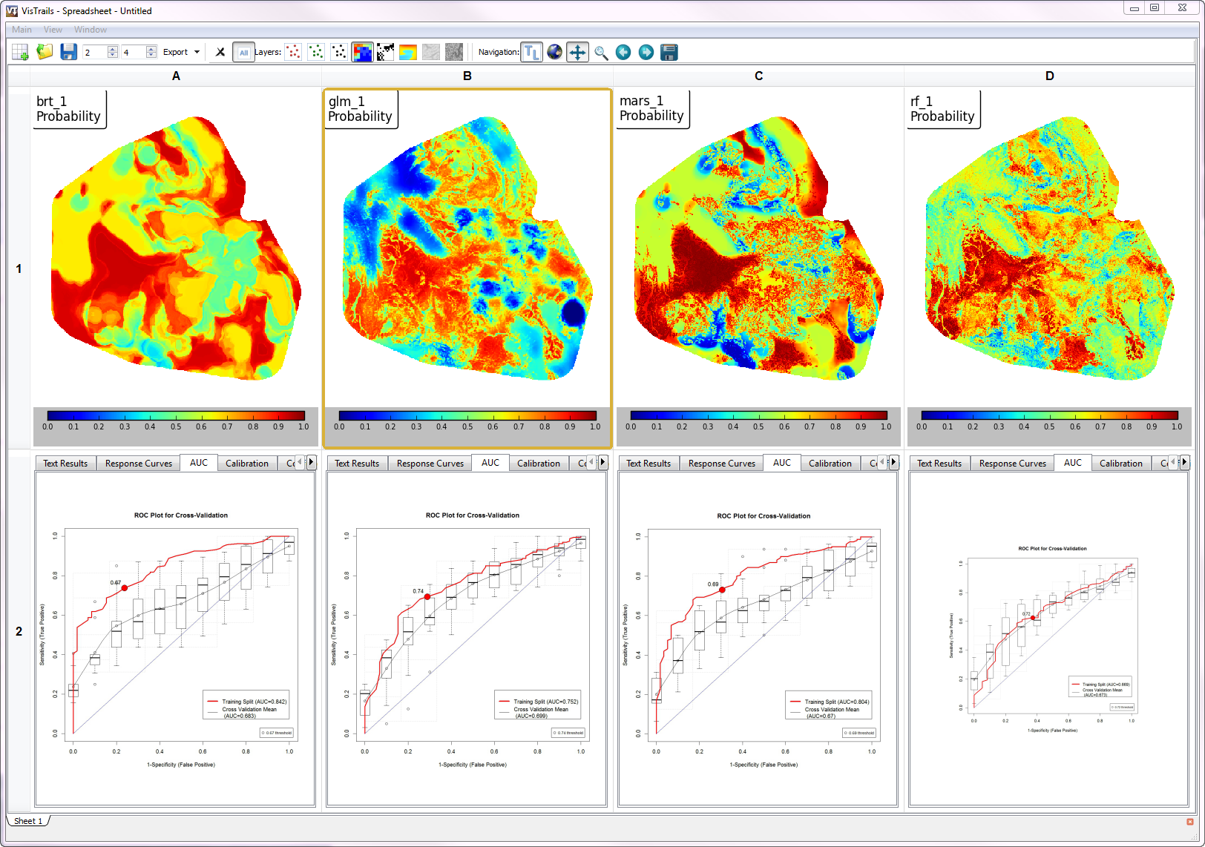
Map toolbar (only visible when a spatial cell is selected
Interactive mini-GIS showing
Spatial Output from Model
Non-Spatial Output from Model

Slide 6
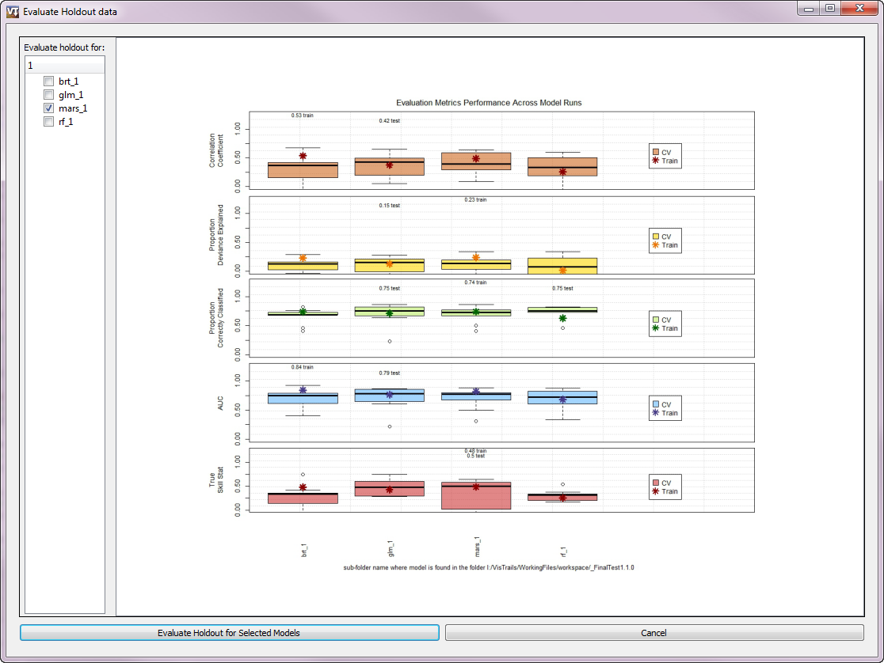
Select models for final evaluation
Chart of model performance metrics
Click here to run final evaluation of holdout data
on checked models
One column for each model

Slide 7
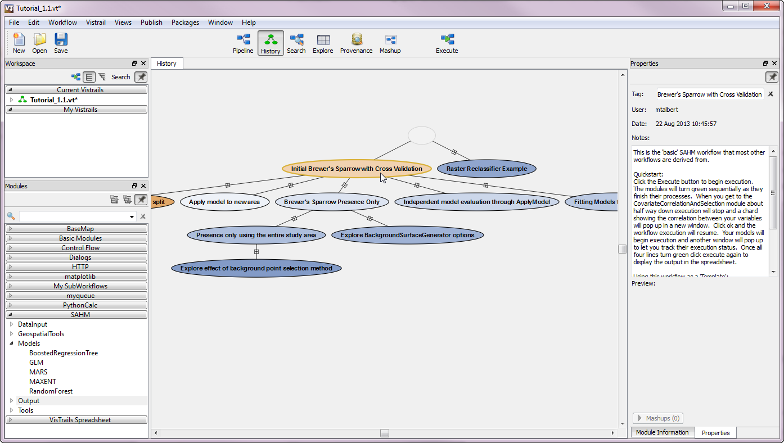
Here is where you switch between the pipeline and history view
Selected node’s tag
Selected node in the workflow history
Write detailed notes about selected node
To compare two nodes we drag the lower node over the upper node this will bring us into a new view
+ signs expand the workflow to show more steps

Slide 8
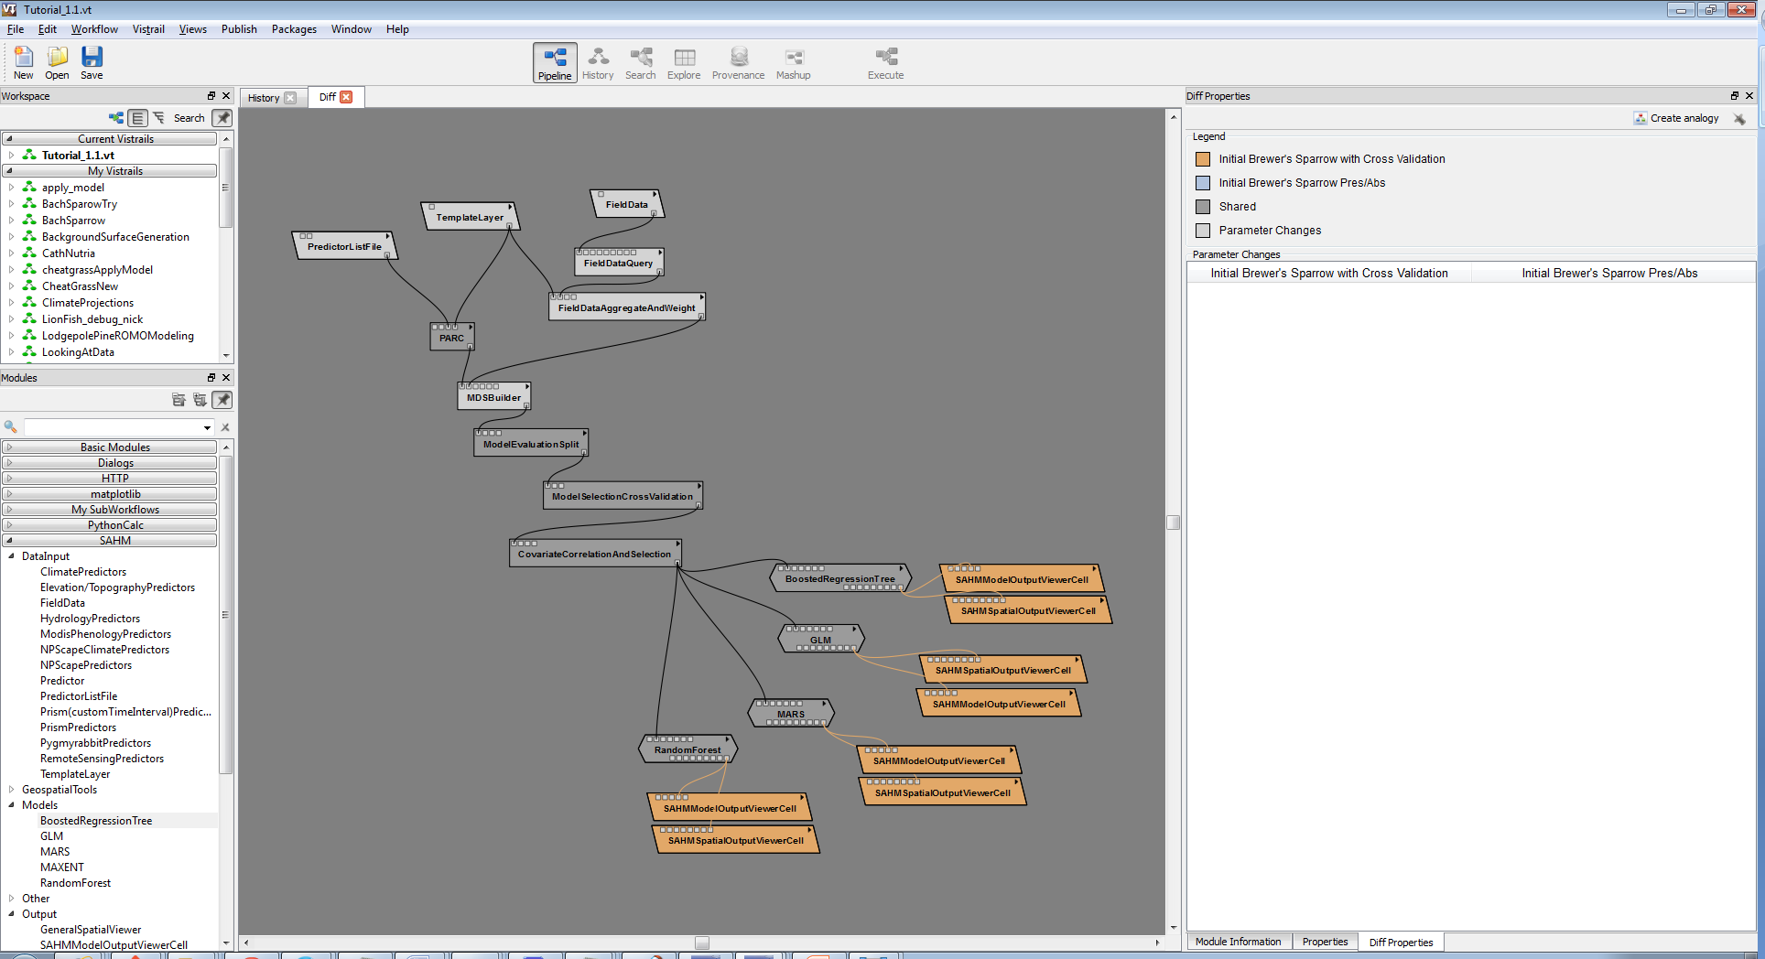
Clicking the x takes us out of the difference view
Modified parameters
Color coding indicates what has been modified
Hit Cntr. R to recenter any workflow on the Canvas

Slide 9
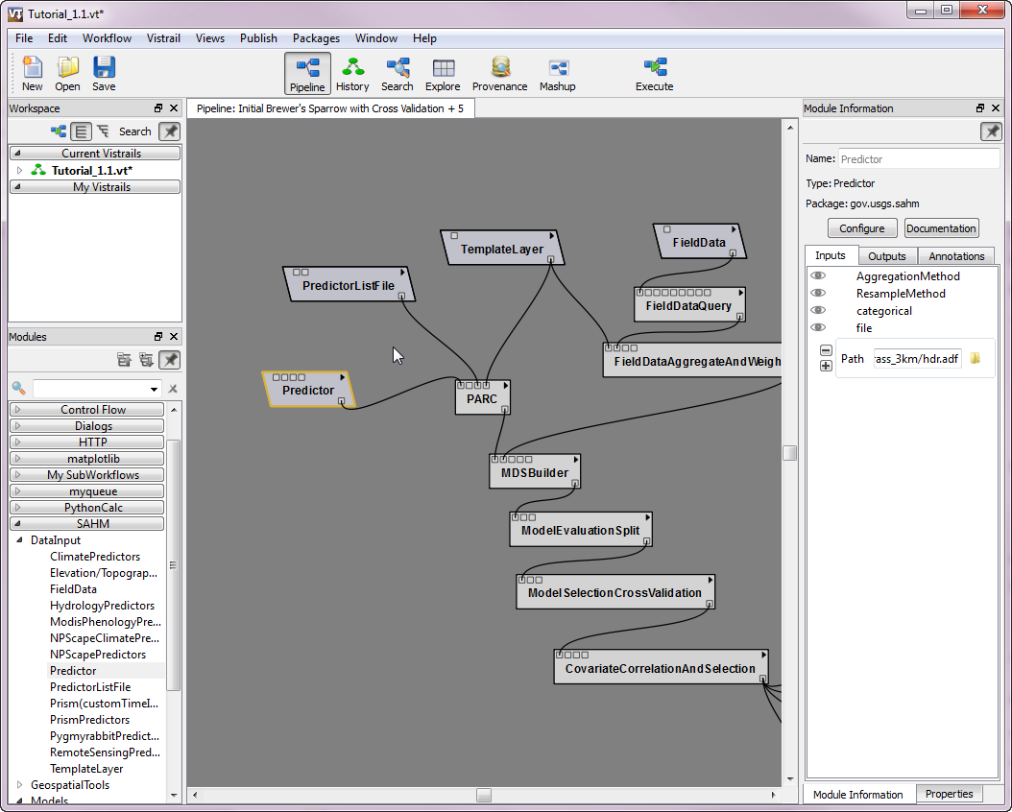
Specify parameters for the new module. Click ‘file’ to expand. Click the ‘folder’ icon to browse to the file
Click and hold to connect output from one module to another’s input port
Drag a new module onto the Canvas

Slide 10
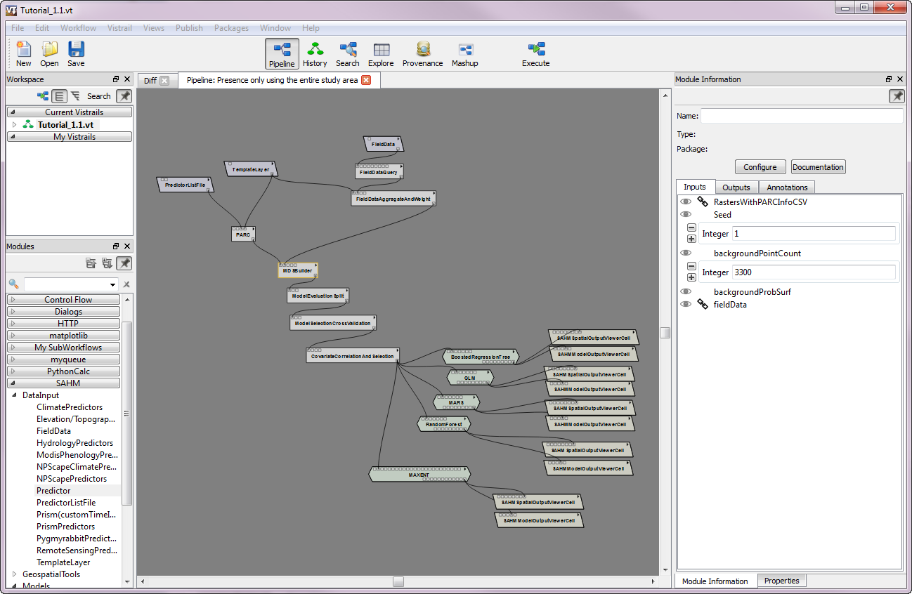

Slide 11
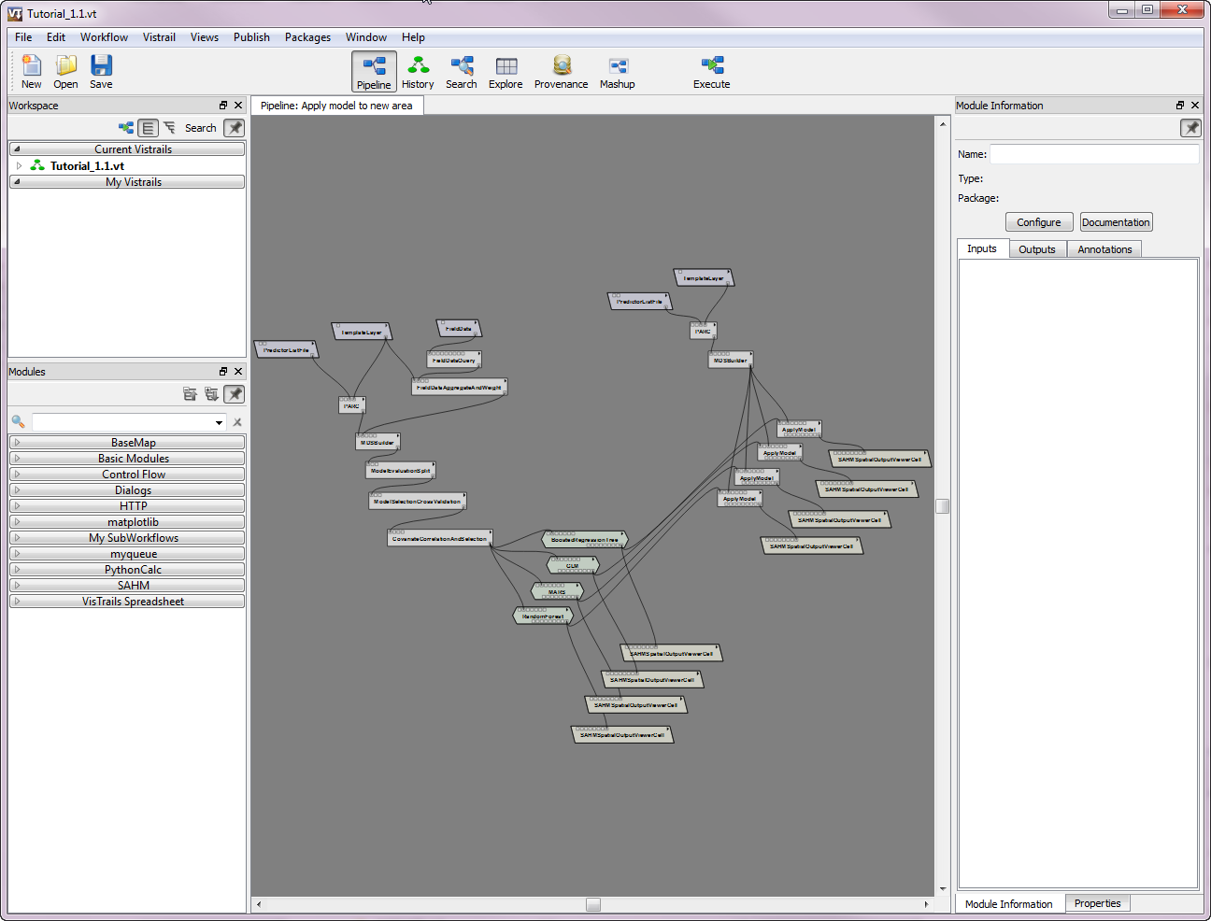

Slide 12
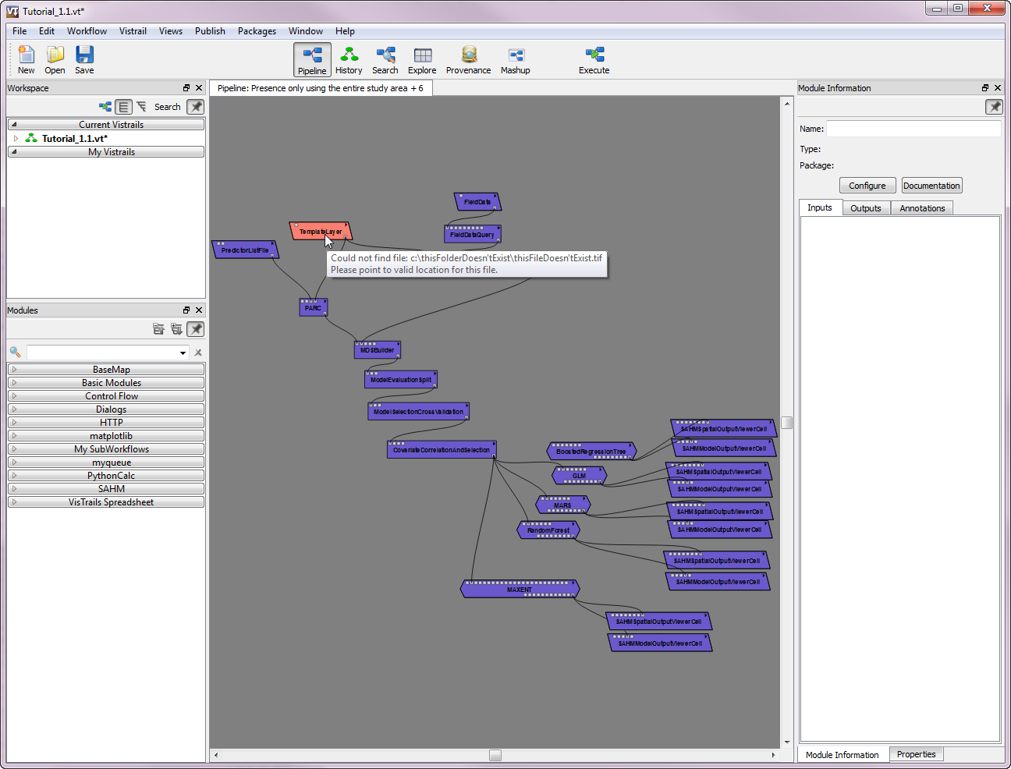

Slide 13
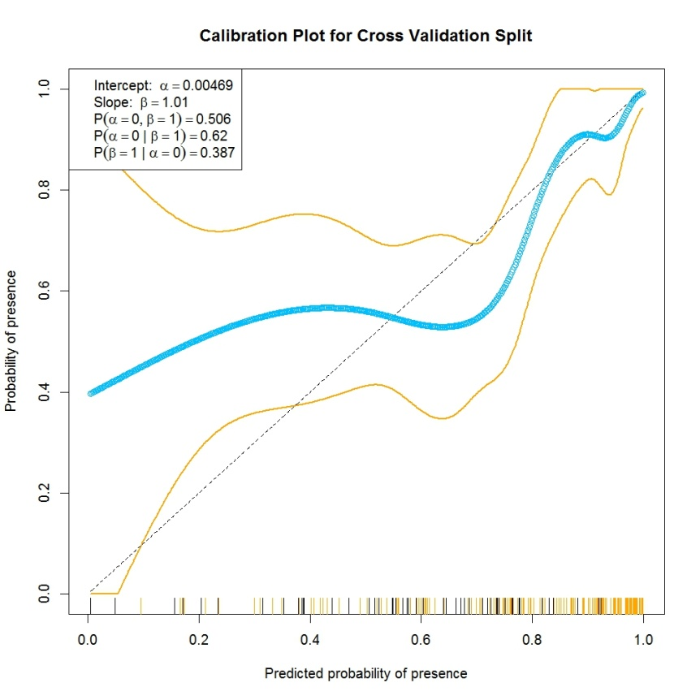
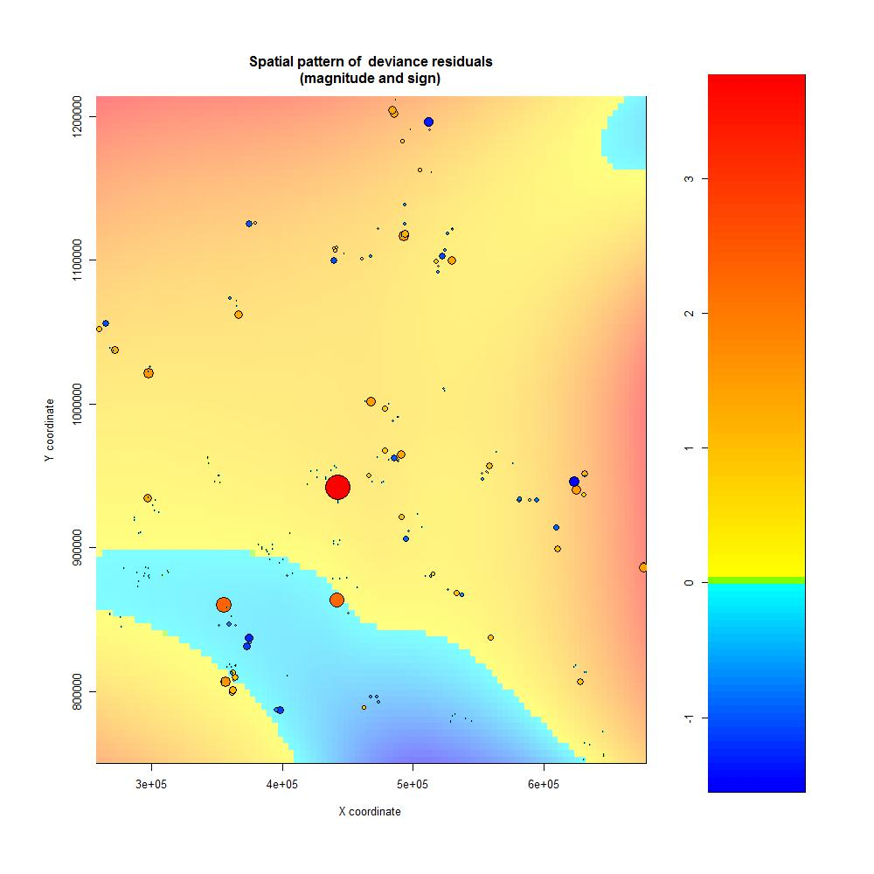
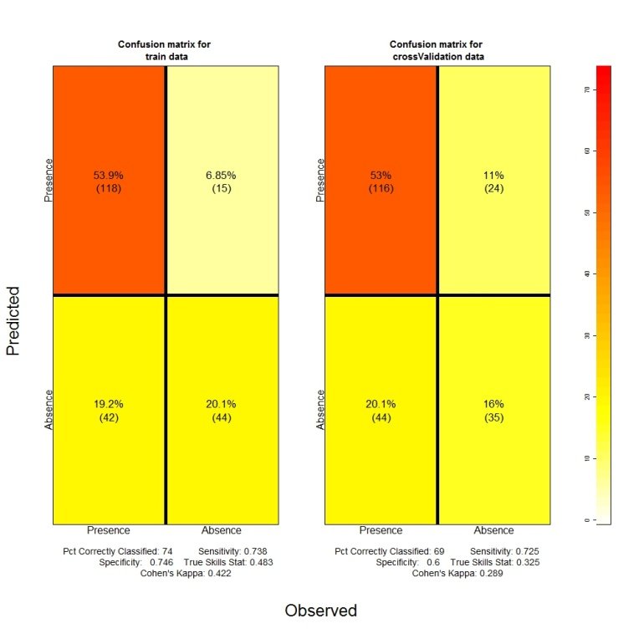
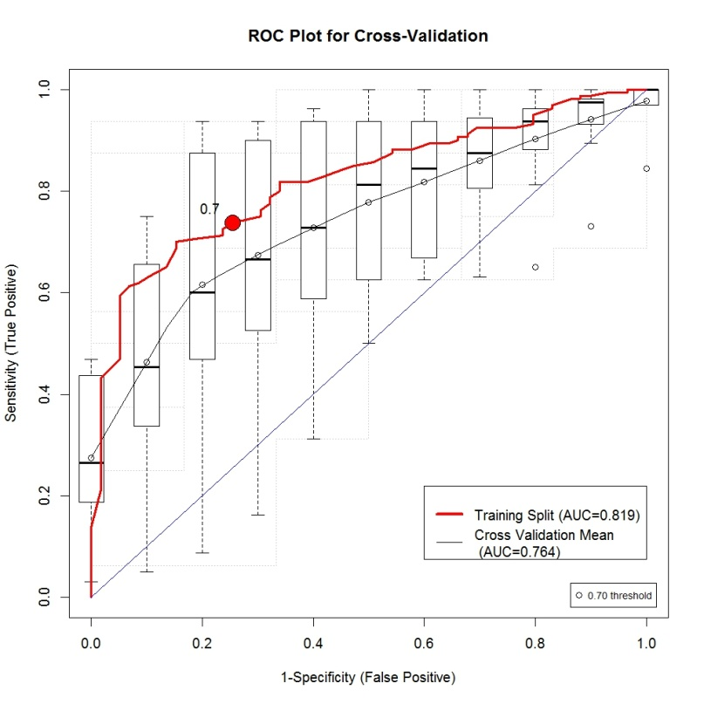

Slide 14
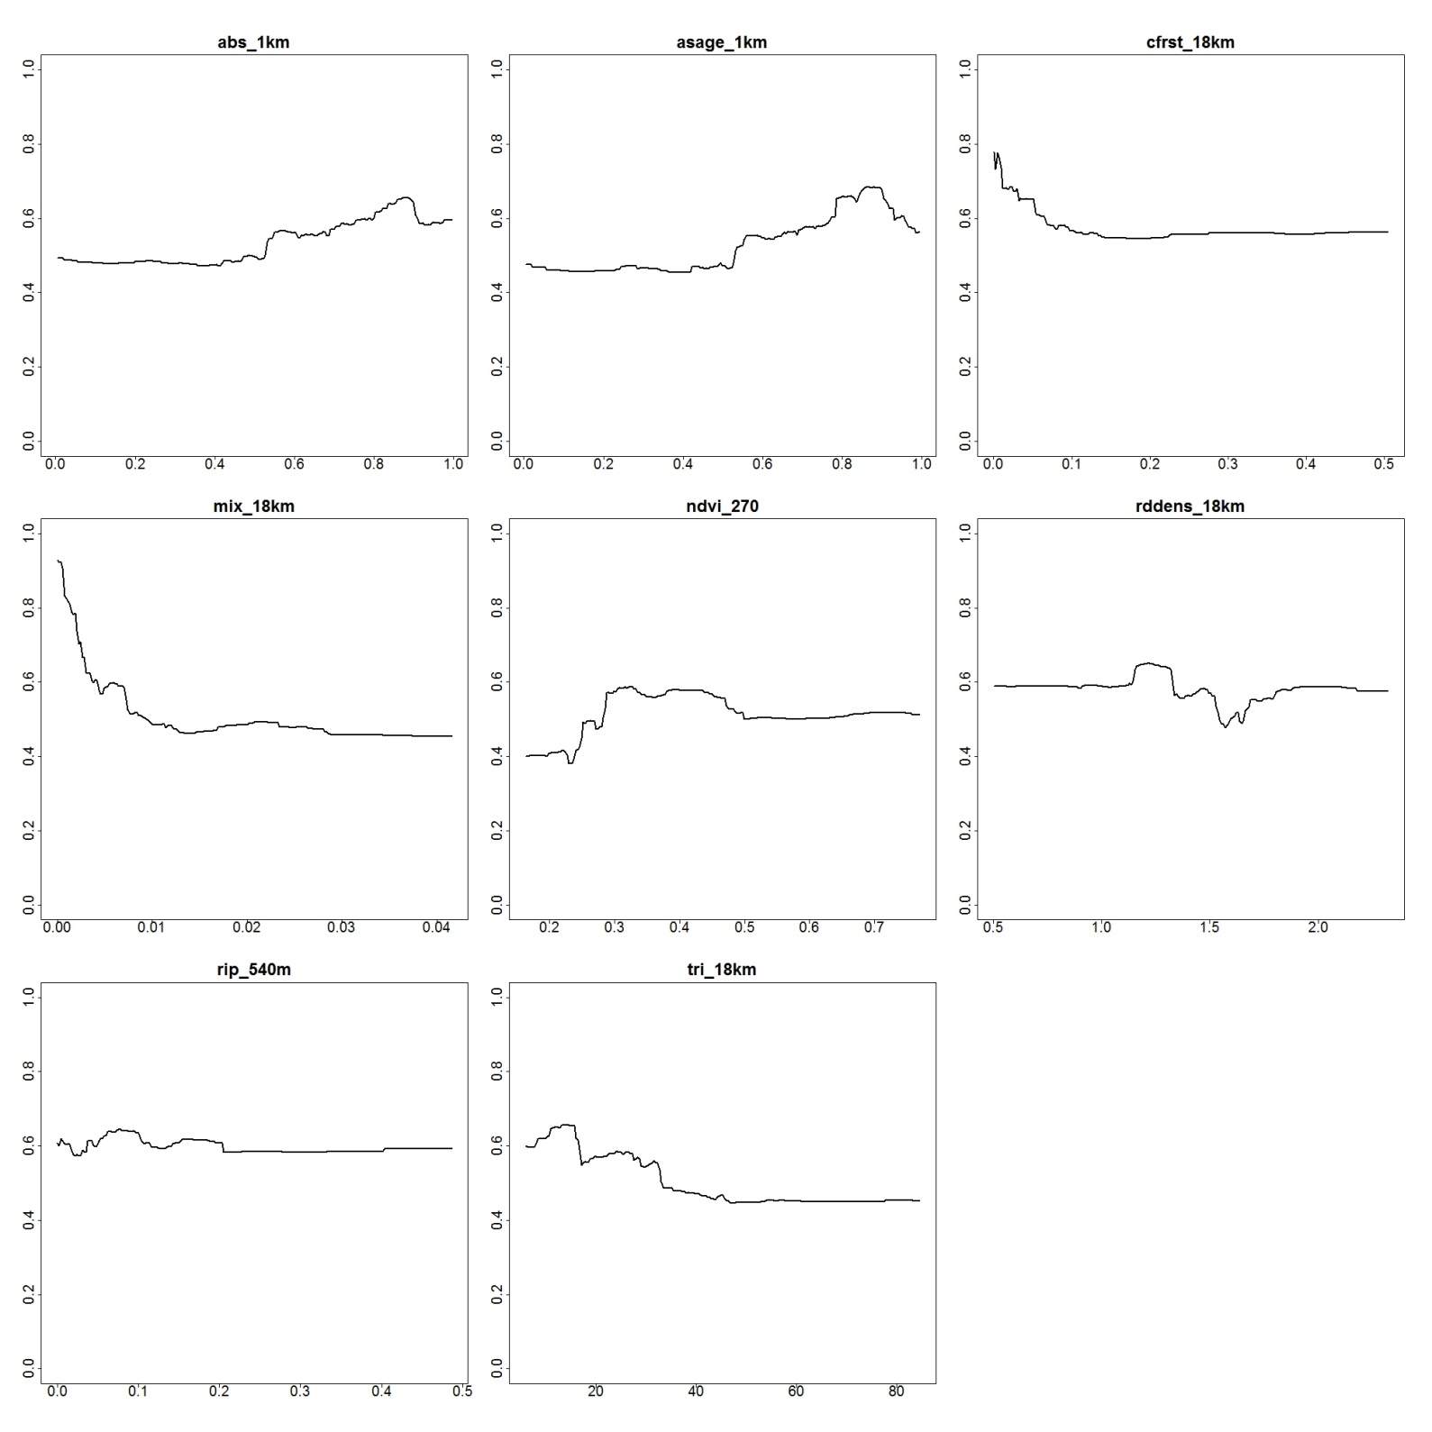

Slide 15
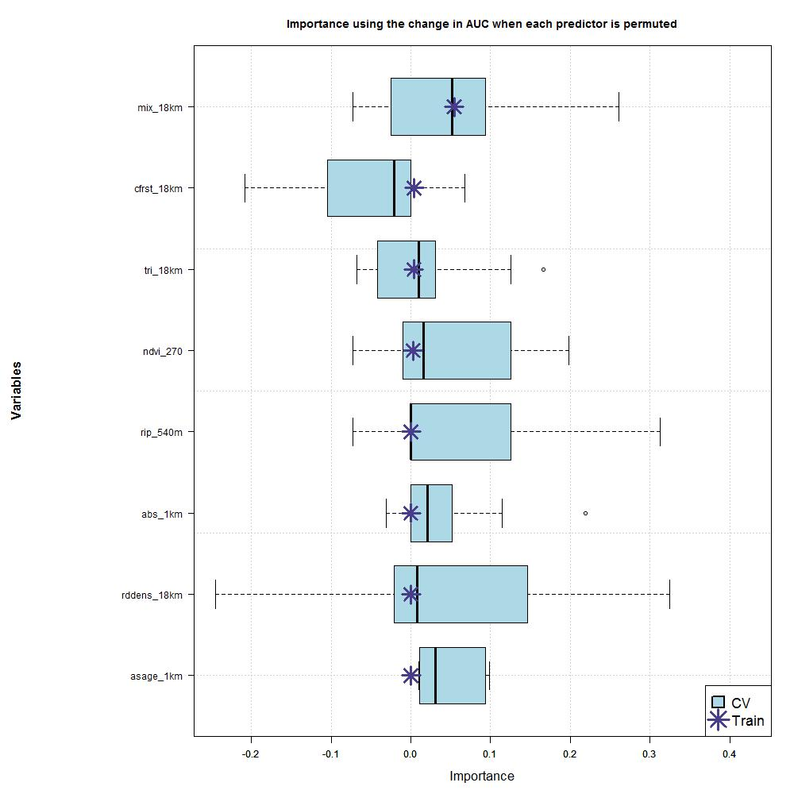

Slide 16
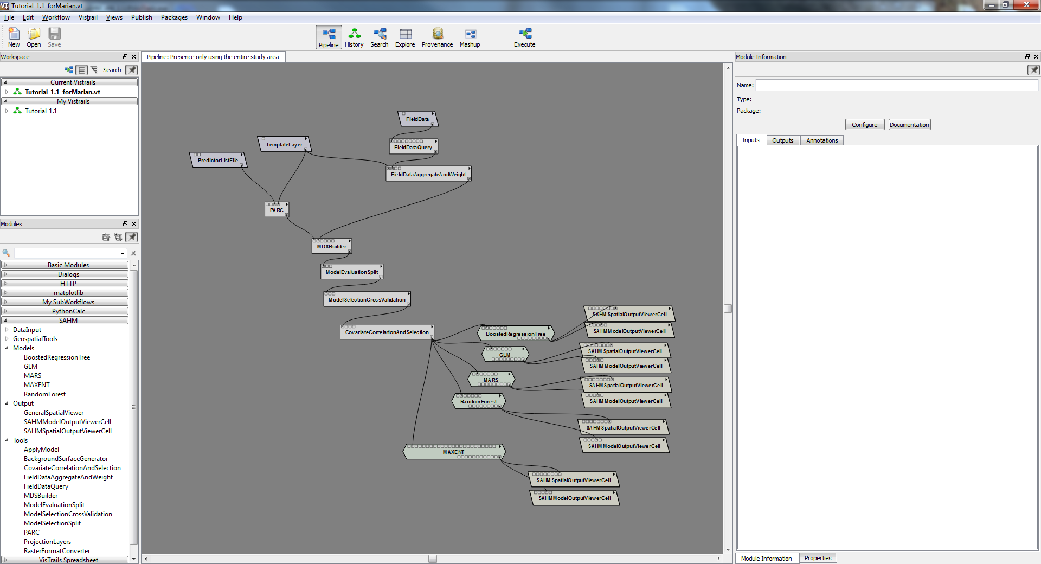
Drag the new modules into the Canvas
Click and hold to connect output from one module to the new module’s input port

Slide 17
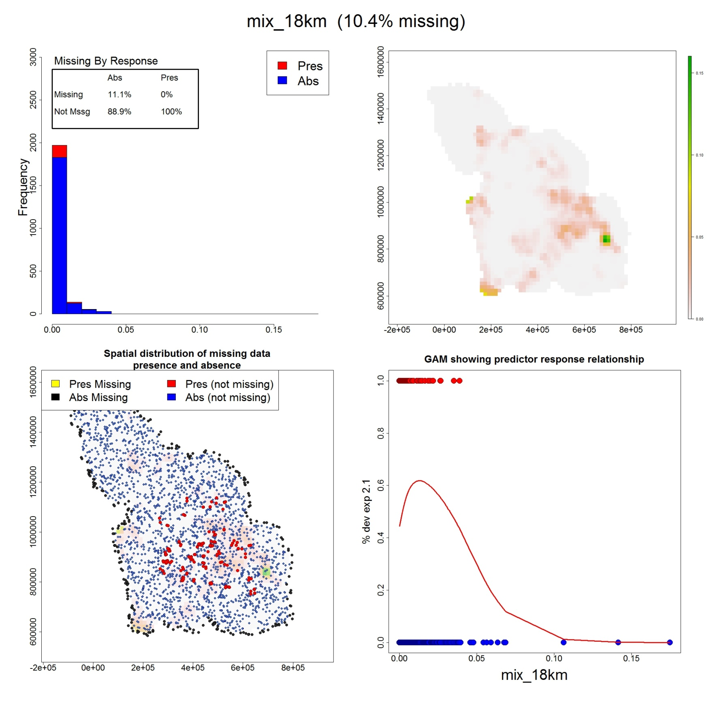

Slide 18
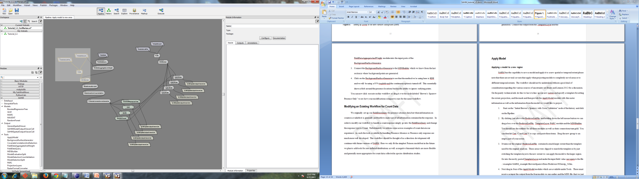

Slide 19
